Slide 1

LR Parsing Algorithm
Compiler Construction

Slide 2
Introducing to LR Parsing
LR parsing: Left-to-right, bottom-up parsing technique
Used in compiler design for syntax analysis
Can recognize a large class of context-free grammars
Efficient and table-driven (uses ACTION/GOTO tables)

Slide 3
Key Concepts of LR Parsing
Stack: Stores grammar symbols and parser states
Input buffer: Holds input string with end marker $
ACTION table: Guides shift, reduce, accept, or error decisions
GOTO table: Selects a new state after a reduction

Slide 4
ACTION/GOTO Table Overview
ACTION[state, input symbol]: tells parser to shift, reduce, accept, or error
GOTO[state, nonterminal]: tells which state to move to after reducing
Tables constructed from the grammar and LR items

Slide 5
LR Parsing Algorithm Steps
Question: Construct an LR parsing table for the given context-free grammar. Parse the input by creating the stack table.
S-->AA
A-->aA|b

Slide 6
Step 1: Find augmented grammar and number it
S'-->.S [0th production]
S-->.AA [1st production]
A-->.aA [2nd production]
A-->.b [3rd production]

Slide 7
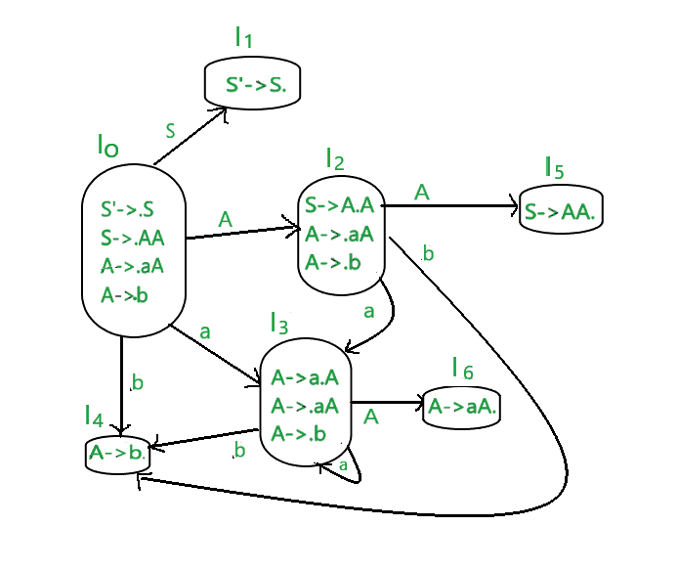
Step 2: Find the LR collection of items or the DFA Diagram

Slide 8
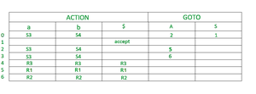
Step 3: Parsing Table

Slide 9
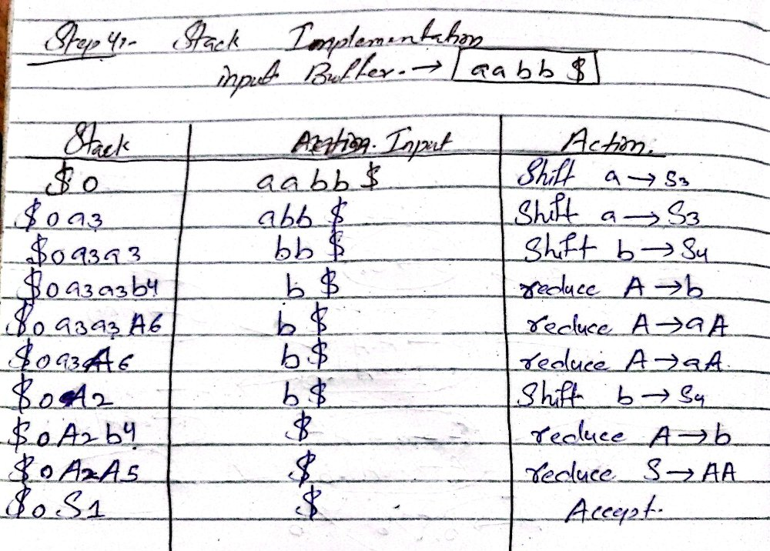
Step 4: Stack Implementation

Slide 10
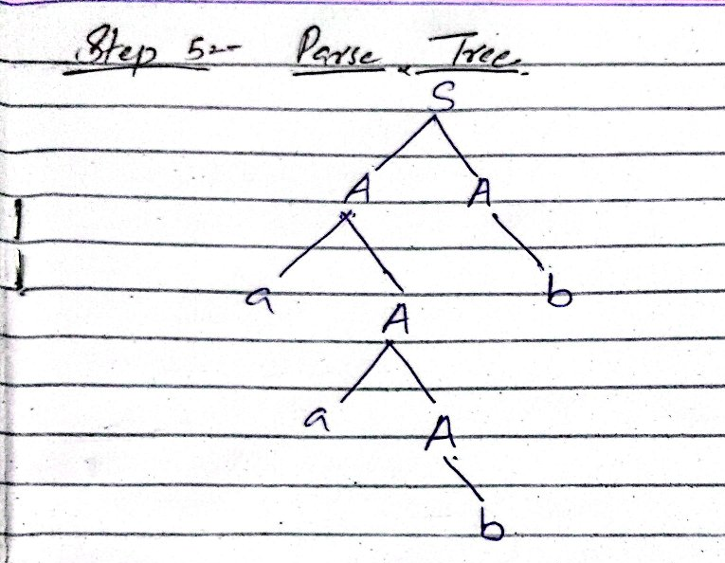
Step 5: Parse Tree

Slide 11
Practice Problem
Question: Construct an LR parsing table for the given context-free grammar. Parse the input by creating the stack table.
Grammar:
E-->BB
B-->cB|d
Input String: ccdd$

Slide 12
Thank You……

